Slide 1

Poland
By,
Vibhuti Shukla (100002512)
Elwin Michael Misquith 100002661)
Rahul Anbu (100003163)
Sufiyaan Javed Shaikh (100003512)
Aishwarya Sachidananda Shetty (100002561)

Slide 2

Contents
Company description
SC design
Inventory planning
Distribution planning
Warehousing & packaging
IT & ordering systems
KPIs
Summary
Literature

Slide 3
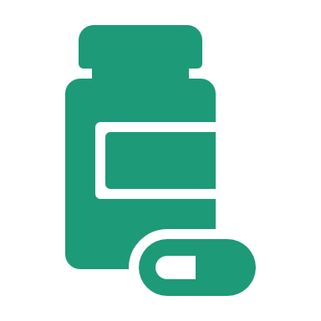
Company Description
Pharmaceutical Distribution company in Poland.
Size: 1,500 – 3,000 m² medium to large
Employees: 100
Target: Cold Chain Optimization
Packaging Efficiency
Inventory Automation
Scalability
Mission
We deliver medicines quickly and reliably to pharmacies across Poland, helping them stay stocked and ready for every patient.
Vision
A future where no pharmacy in Poland faces shortages, thanks to our cutting-edge logistics and customer-first approach
Strategy
Build a network of regional warehouses with cold chain capabilities.
Smart routing software to optimize delivery times and reduce costs.

Slide 4
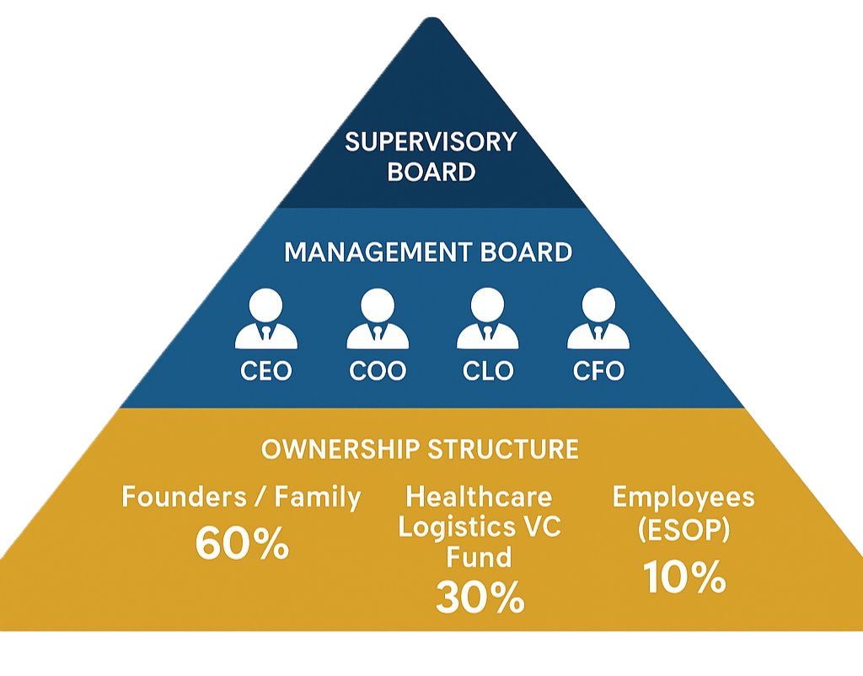
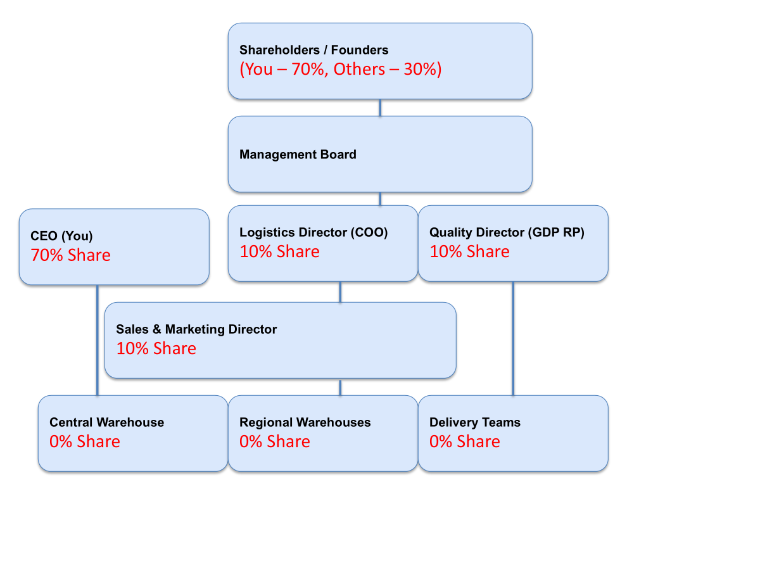
Formal Setup & Ownership Hierarchy
Strategic Oversight: Founding Entrepreneurs, external advisors, strategic Investors
Operational Management: Management Board/ Core Leadership
Employee Stock Ownership Plan (ESOP)

Slide 5
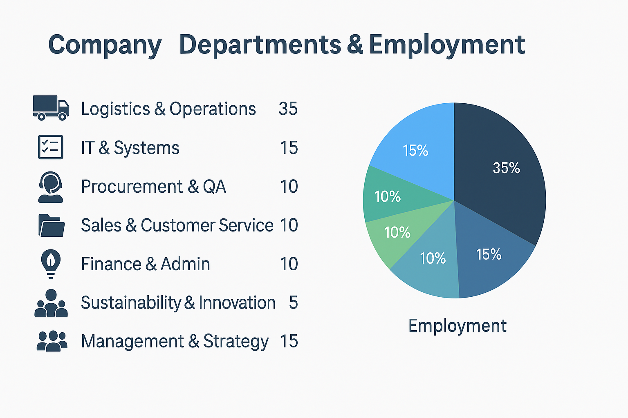
Company departments & employment
7 key departments:
The organizational structure supports reliable cold chain operations, digital systems integration, and pharmaceutical distribution across Poland.

Slide 6

Supply Chain Design

Slide 7







SC Design: Overview
Cities
Pharmacies
Customers
Regional Warehouse 1
Regional Warehouse 2
Central Warehouse
Regional Warehouse 3
Cross Dock

Slide 8
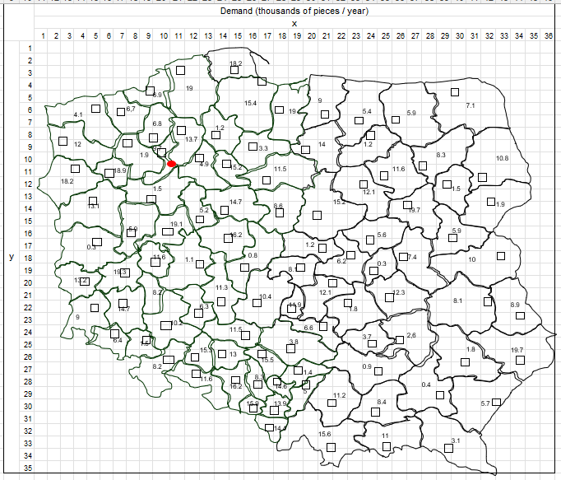
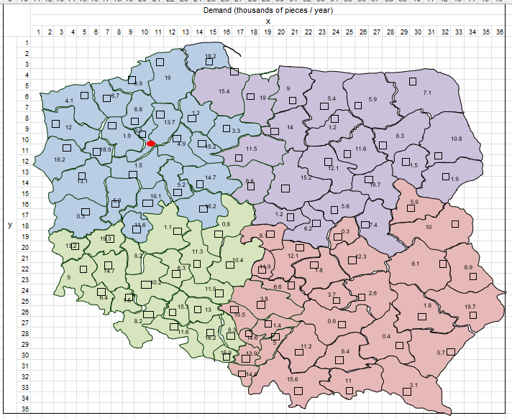
SC Design: Zoning
Poland has been divided into 4 zones based on the median values of the geographical coordinates.

Slide 9
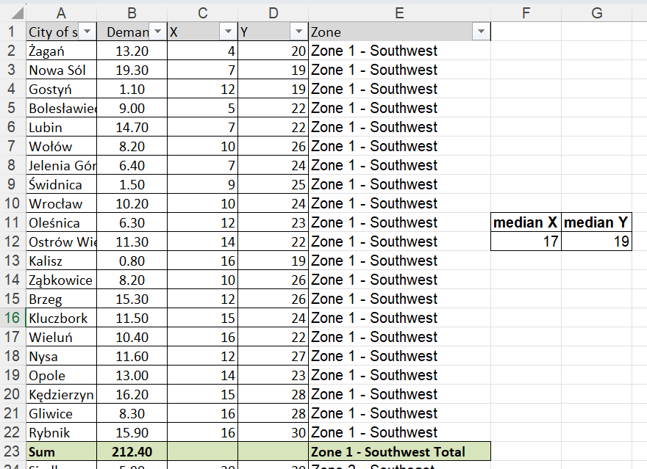
Coordinates based Median Zoning
Criteria Considered :
- Zone 1: X < 17 and Y ≥ 19 (Southwest)
- Zone 2: X ≥ 17 and Y < 19 (Northeast)
- Zone 3: X < 17 and Y < 19 (Northwest)
- Zone 4: X ≥ 17 and Y ≥ 19 (Southeast)

Slide 10
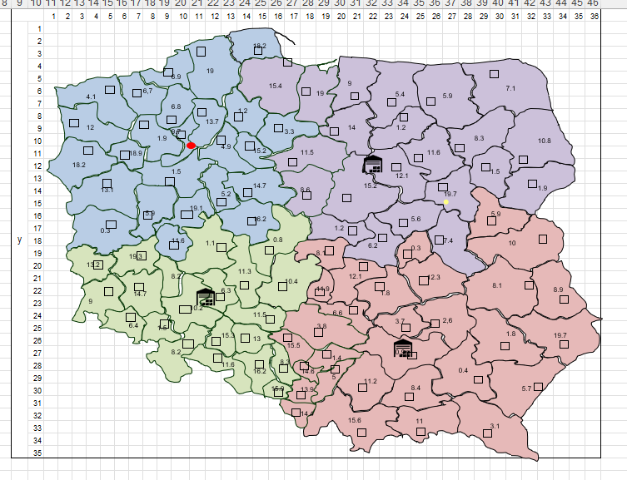
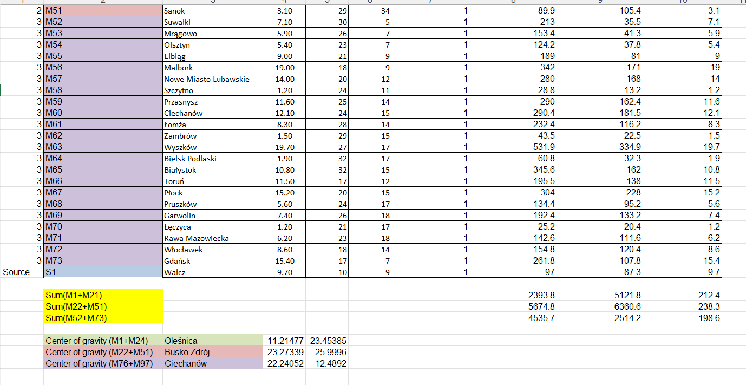
SC Design: Regional warehouses
We have located our warehouses based on the center of gravity and compared it against some critical success factors

Slide 11
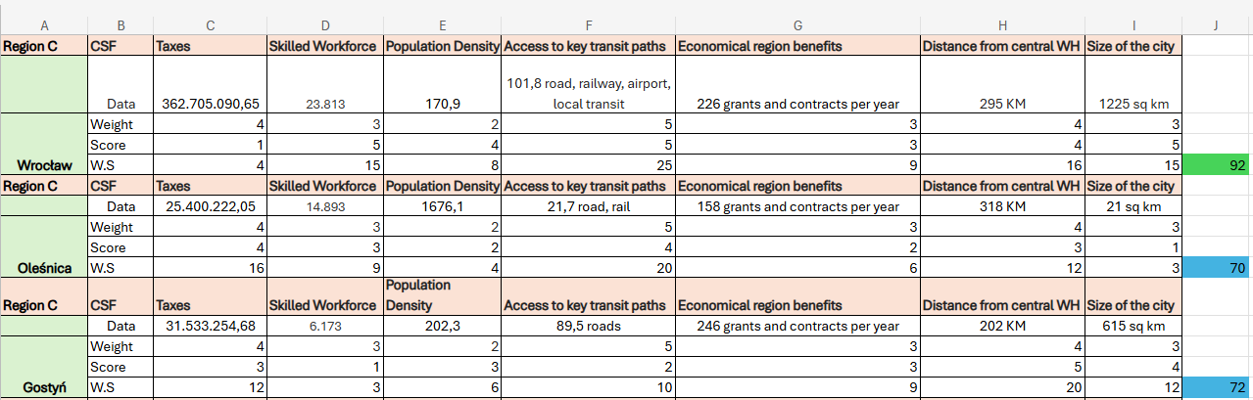
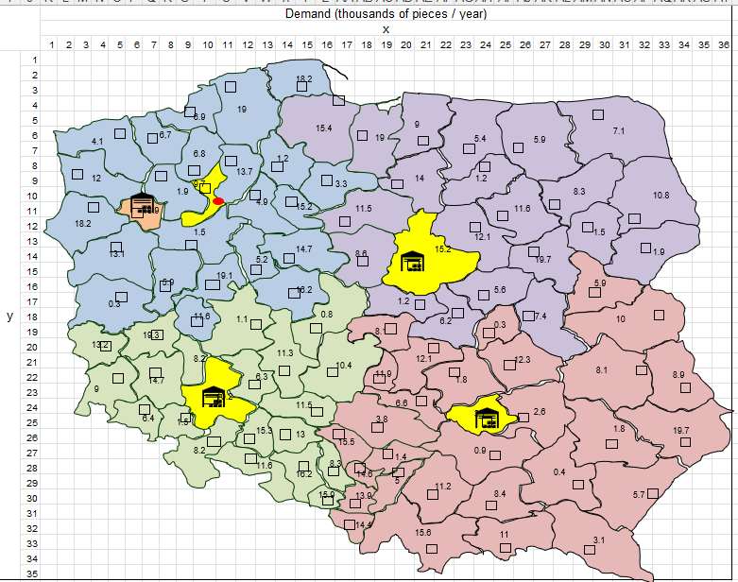
Regional warehouses : Success factors
For Southwest Zone : Wrocław serves 20 cities
For Southeast Zone : Kielce serves 29 cities
For Northeast Zone : Plock serves 21 cities
For Northwest Zone : Central Warehouse
Walcz serves 3 regions and Cross-dock Choszczno serves 23 cities

Slide 12

Inventory

Slide 13
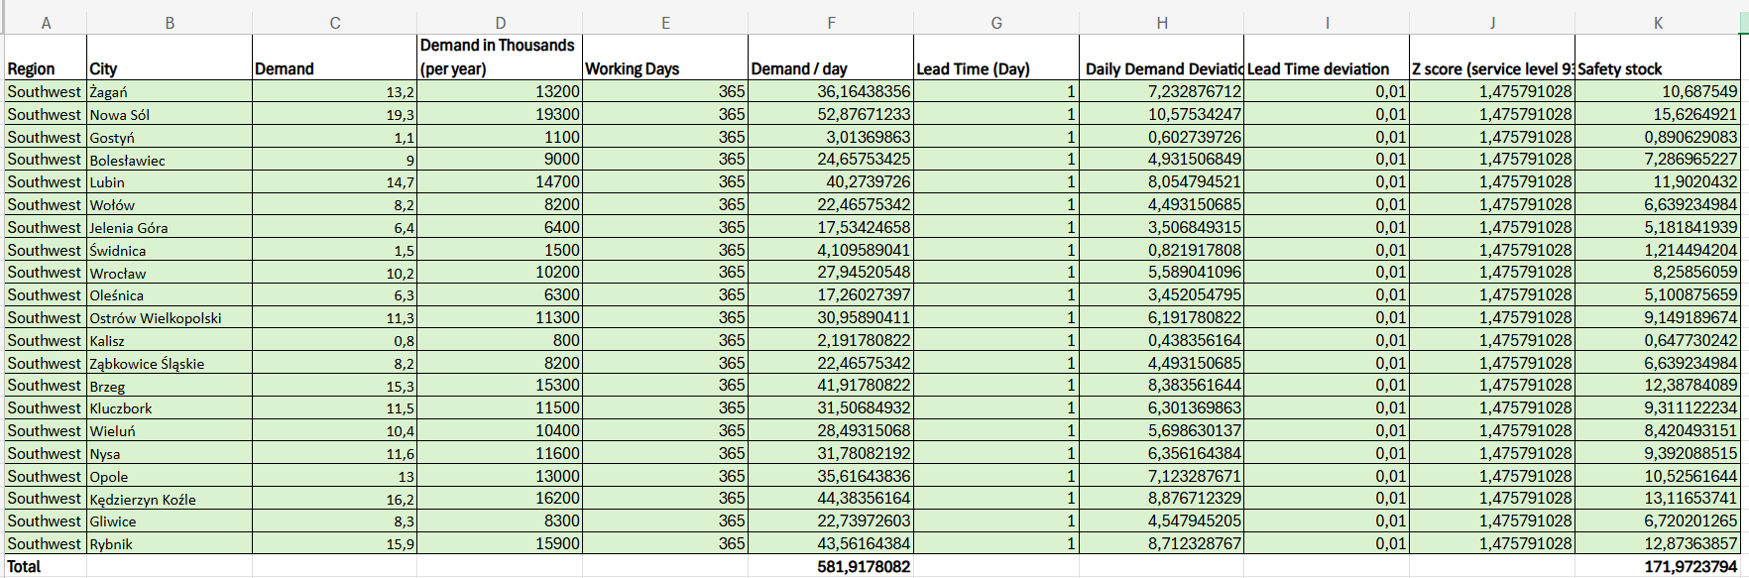
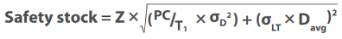
Inventory Planning
Inventory levels are derived using city-level daily demand and lead time variability.
A 95% service level (Z = 1.4757) is used to ensure high product availability.
Daily demand deviation is calculated per city based on annual demand.
Safety stock is calculated per city based on demand deviation to ensure a 95% service level across the distribution zone.

Slide 14
Inventory: Our Product line
Storage Type | Product Type | Product | Shelf Location
Cold Room (2–8°C) | Injectables | Insulin Injection | CR-1-1
Ambient (15–25°C) | Tablets, Capsules, Syrups | Calcium Chewable Tablet | AM-2-3
Frozen (–15 to –25°C) | Vaccines | mRNA Vaccine | FR-1-2
Inventory is categorized based on temperature sensitivity to ensure cold chain compliance and safety. Each product type has designated storage zones and handling SOPs.
Cold Room (2–8°C) → Syrups, injectables, biologics
Ambient (15–25°C) → Tablets, capsules, general medicines
Frozen (–15 to –25°C) → Vaccines, APIs (stored centrally)

Slide 15

Distribution Planning

Slide 16
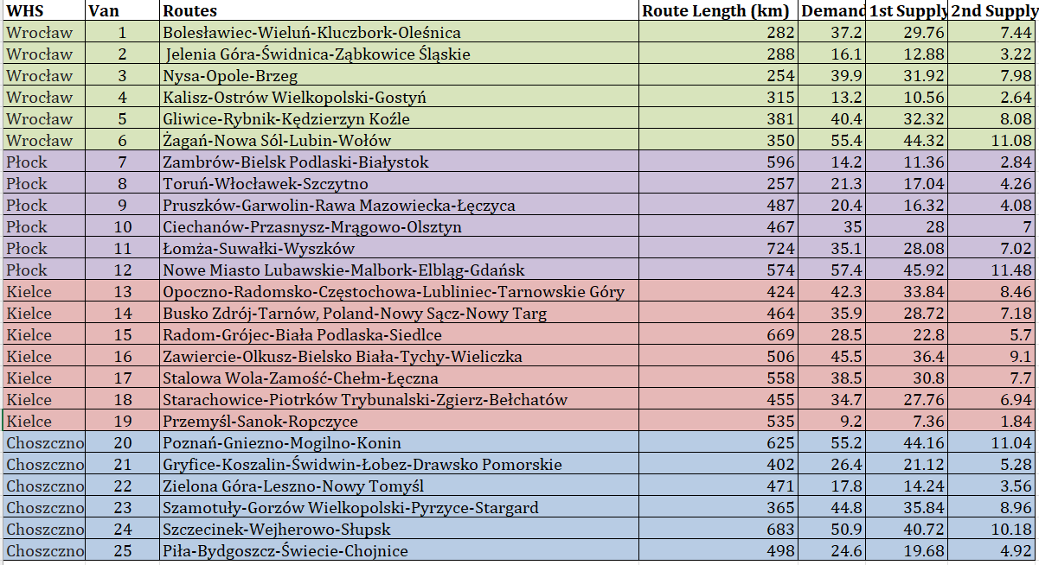
Routes : Traveling Salesman
We have used the OptimoRoute tool to solve the TSP problem to find the shortest possible route

Slide 17
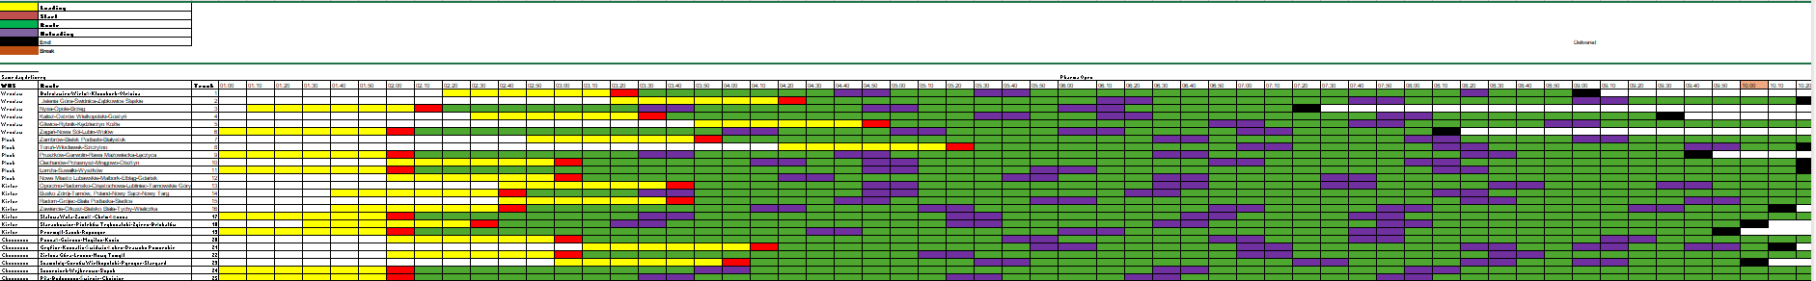
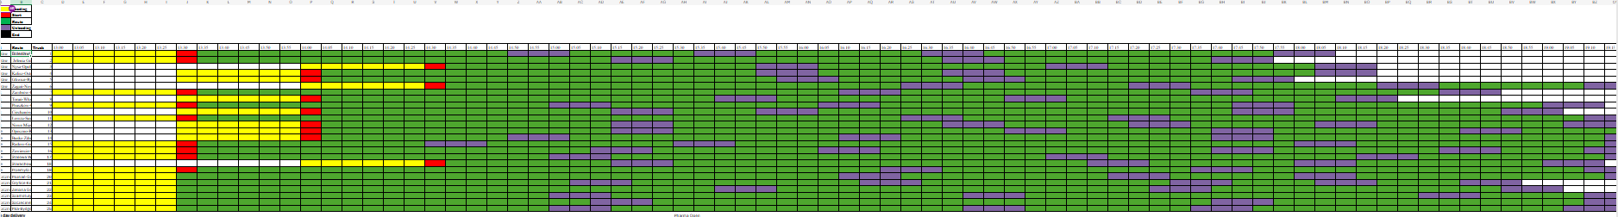
Distribution: 1st & 2nd delivery

Slide 18
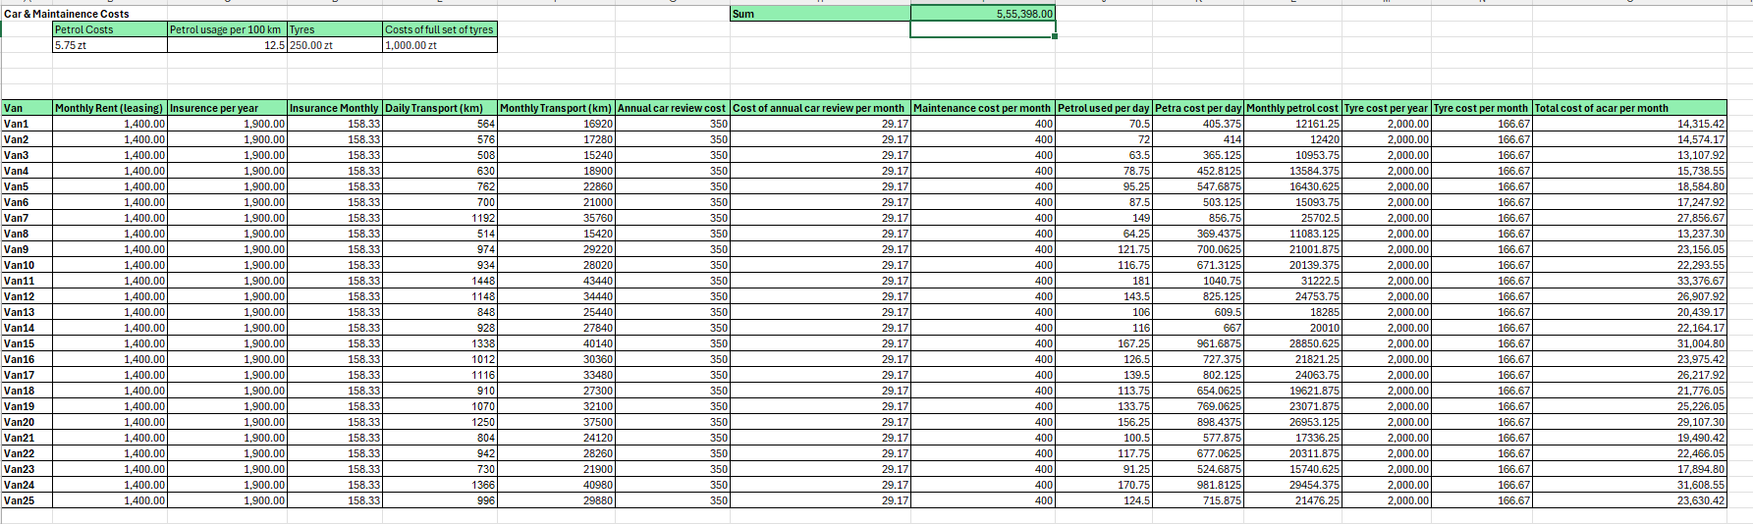
Transportation Costs

Slide 19

Warehouse Design

Slide 20
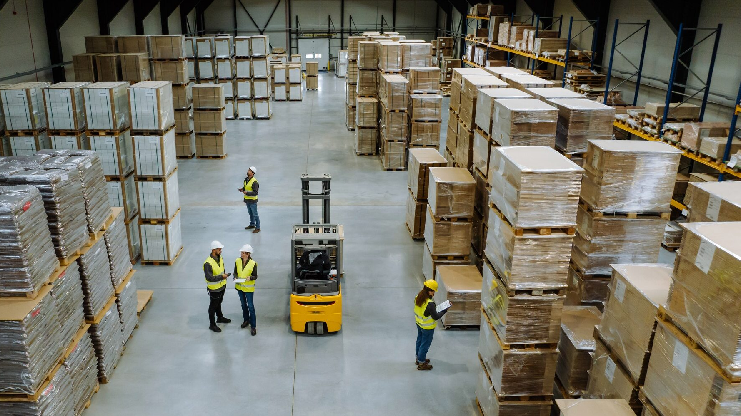
U shape + Modular zoning
INFLOW-OUTFLOW OF GOODS
Docks are at same front wall, supports efficient supervision & security
MULTIPLE OUTFLOW ASSEMBLY
For picking, packing and assembly zones middle area will be ideal which is near to the outbound as well
WORKFORCE
MULTIPLE TEMPERATURE ZONES
Modular zones will prevent blockage of path between main workflow area
Ambient, cold, frozen zones are separated ensure GDP compliance

Slide 21
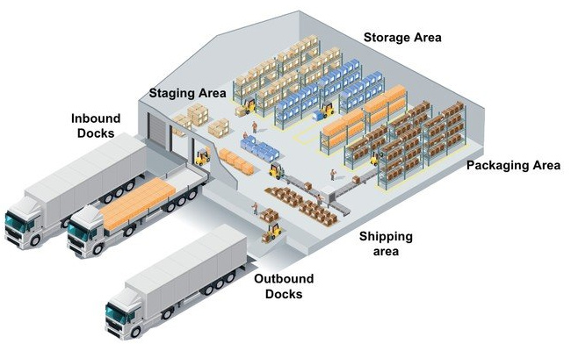
Warehouse Design: Layout
U shape + Modular with receiving and dispatch located on the same side
Modular approach with dedicated zones for:
Cold Room (2–8°C): temperature-sensitive items
Ambient Storage (15–25°C): general medicines
Order Picking: manual or semi-automated retrieval
Packaging Area: assembly, labeling, and sealing
Dispatch Bay: final shipment loading
Forklift and pathway design enables efficient and non-overlapping material movement.
Layout supports traceability, hygiene control, and cold chain continuity in pharmaceutical distribution.

Slide 22
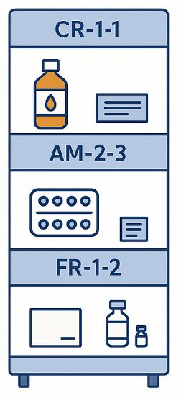
Warehouse Design: Sorting & Shelving System
Products are sorted based on storage type and product category (e.g., syrups, tablets, injectables).
Shelf codes follow a structured format:
CR-1-1 → Cold Room, Rack 1, Shelf 1
(A to Z)-1-2→ Ambient Storage
FR-1-2 → Frozen Storage, Rack 1, Shelf 2
FEFO (First Expiry, First Out) is applied to cold and frozen items.
FEFO method used for expiry-sensitive items.
Shelf labels include barcodes/QR codes for tracking.
High-turnover items are placed on accessible lower levels.
(A to Z)-1-2

Slide 23
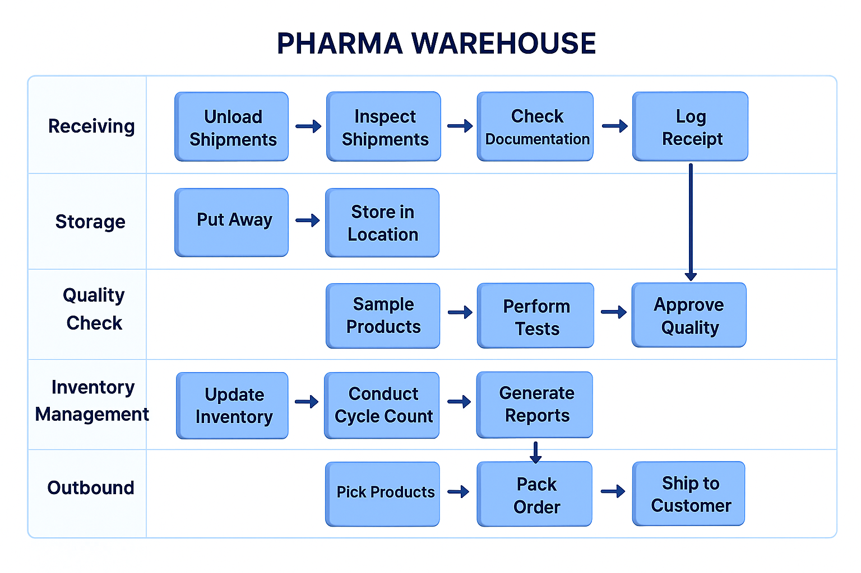
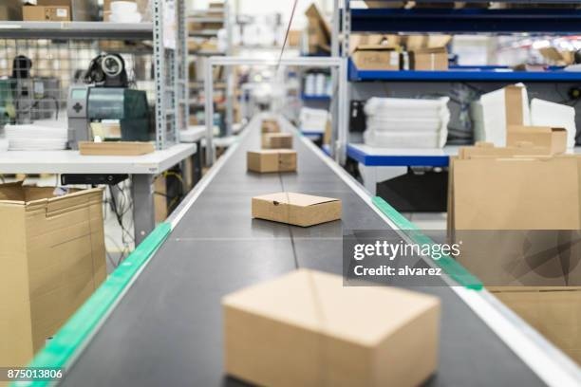
Swimlane Diagram, Order Picking Equipment
Central Warehouse
Using conveyor systems for central
warehouse, AGVs
Regional Warehouse
Manual Equipements like trolleys,
basic conveyor system

Slide 24
Packaging & Delivery

Slide 25

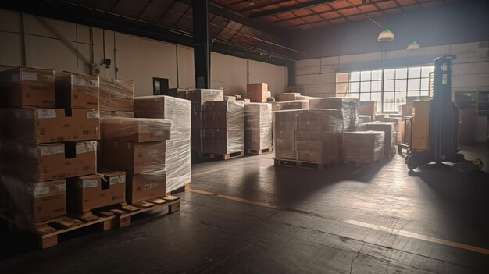
Packaging
Products are packaged by form and storage need (e.g., syrups, tablets, injectables).
Primary packaging: Blister packs, bottles, vials with barcoded labels.
Secondary packaging: Boxes with cushioning, leaflet inserts, and tamper-evident seals.
Cold chain items include insulated containers, gel packs, and temperature indicators.
Packaging design supports traceability, compliance (GDP), and minimal damage risk.
Each package is labeled with batch number, expiry, storage zone code (e.g., CR-1-1).
Packaging ensures product integrity, safety and cold chain continuity from warehouse to pharmacy.

Slide 26

IT & Ordering systems

Slide 27
IT & Ordering systems
OMS (Order Management System) receives pharmacy orders via EDI , triggering fulfillment in the ERP.
ERP coordinates demand with MRP (Material Requirements Planning) and WMS (Warehouse Management System) for execution.
WMS handles warehouse tasks: receiving, picking, dispatch, and stock tracking.
VMI (Vendor Managed Inventory) enables shared visibility between warehouses and manufacturers.
CRM(Customer Relationship Management) tracks warehouse performance, order issues and manufacturer feedback.
Integration of all systems ensures real-time visibility, demand planning, and cold chain control .
Pharmacies
OMS
ERP
EDI
Regional & Central WHs
MRP
WMS
Regional & Central WHs
VMI
Manufacturer
CRM

Slide 28
KPIs
KPI Name | Definition | Target Example
OTIF (On Time In Full) | % of orders delivered on time and without shortages | ≥ 98%
Inventory Turnover | How often inventory is sold and replaced in a year | 10–15 times/year
Stockout Rate | % of SKUs with zero inventory when demanded | ≤ 5%
Order Lead Time | Avg. time from pharmacy order to delivery | < 8 hours
Emergency Response Time | Avg. time to fulfill urgent deliveries | < 2 hours in key cities
Cold Chain Compliance | % of temperature-sensitive products stored/delivered within 2–8°C range | 100%
Carbon Emission per Delivery | Emissions from vehicle per delivery route (kg CO₂) | -30% (vs. baseline year)
Return Rate | % of deliveries returned due to issues (wrong items, damaged) | ≤ 1%
Real-time dashboards for delivery tracking (using GPS from smart routing software)
Inventory monitoring system showing levels in central + regional warehouses
Cold chain sensor data integrated via IoT for temp-sensitive items
Alerts for delays, missed deliveries, or deviations
KPI Monitoring Module: Automatically tracks OTIF, stockouts, lead time
Feedback loop from CRM to track pharmacy satisfaction
Sustainability tracking: Emission per route, e-vehicle usage stats

Slide 29

Summary
Designed a cold chain pharma distribution network across Poland with 4 warehouse zones.
Applied zoning, center-of-gravity and demand-based inventory planning (95% service level).
Built a U-shaped modular warehouse layout with ambient, cold and frozen zones.
Used coded shelving, FEFO and temperature tracking for product safety.
Integrated ERP, WMS and IoT for real-time visibility and KPI tracking.

Slide 30
Literature
Academic Sources:
Köse, E., Düzenli, B., Çakmak, S., & Vural, D. (2022). Medicine distribution problem between pharmacy warehouse and pharmacies. Sādhanā, 47, Article 171
de Koster, R., Le-Duc, T., & Roodbergen, K. J. (2007). Design and control of warehouse order picking: A literature review. European Journal of Operational Research, 182(2), 481–501.
Goel, S., & Hann-Caruthers, W. (2022). Optimality of the coordinate-wise median mechanism for strategyproof facility location in two dimensions (arXiv:2007.00903v5). arXiv.
Website:
OptimoRoute Inc. (n.d.). Route planning and optimization software.
https://bdl.stat.gov.pl/bdl/start

Slide 31

Thank You
A safe, efficient and digitally enabled pharma supply chain optimized for Poland.

